Slide 1



Air Quality Index (AQI) Prediction using Machine Learning
Name:k.satya sathvik
Reg no:22BCE8492
College Name:
Vellore Institute of Technology, Andhra Pradesh

Slide 2

Learning Objectives
Understand the impact of air pollution on public health and climate.
Learn how to preprocess and analyze air quality datasets.
Explore data visualization techniques for pollution trends.
Apply machine learning techniques for AQI prediction.
Develop a web application to display real-time AQI predictions.
GOAL
Source :
www.freepik.com/

Slide 3
Tools and Technology used
Programming Language: Python
Libraries: NumPy, Pandas, Matplotlib, Seaborn, Scikit-learn, Streamlit
Data Processing & Modeling: StandardScaler, Machine Learning
Models (Regression, Decision Trees, etc.)
Visualization Tools: Seaborn, Matplotlib
Web Framework: Streamlit

Slide 4
Methodology
Data Collection:
Load the air quality dataset containing pollutant concentrations.
Data Preprocessing:
Handle missing values by replacing them with mean values.
Remove duplicate data and irrelevant columns.
Normalize the dataset using StandardScaler.
Exploratory Data Analysis (EDA):
Univariate and bivariate analysis of pollutants.
Heatmap visualization for correlation analysis.
Box plots to detect and handle outliers.
Feature Selection & Model Building:
Select important pollutant features influencing AQI.
Train different machine learning models to predict AQI.
Model Evaluation & Optimization:
Evaluate models using error metrics (RMSE, R² score).
Fine-tune models for improved accuracy.
Web Application Development:
Integrate the model into a Streamlit-based web app.
Deploy the app for real-time AQI prediction.

Slide 5
Problem Statement:
Air pollution is a serious environmental issue affecting public health and climate. Traditional AQI monitoring relies on expensive, fixed-point sensors, which limit coverage. The goal of this project is to develop a machine learning model for AQI prediction based on pollutant concentrations, making air quality assessment more accessible.

Slide 6
Solution:
Data-Driven AQI Prediction: Utilize machine learning models to predict AQI based on pollutants like PM2.5, PM10, NO2, SO2, CO, and O3.
Handling Missing Data: Implement strategies to fill missing values in the dataset.
Outlier Detection & Feature Engineering: Use statistical methods to handle outliers and improve model accuracy.
Visualization & Analysis: Use graphical tools to explore trends and correlations between pollutants.
Web-Based Implementation: Deploy a Streamlit-based web application for real-time AQI monitoring.
GitHub : https://github.com/Sathvik2005/Air-Quality-Index-Prediction-aicte-

Slide 7
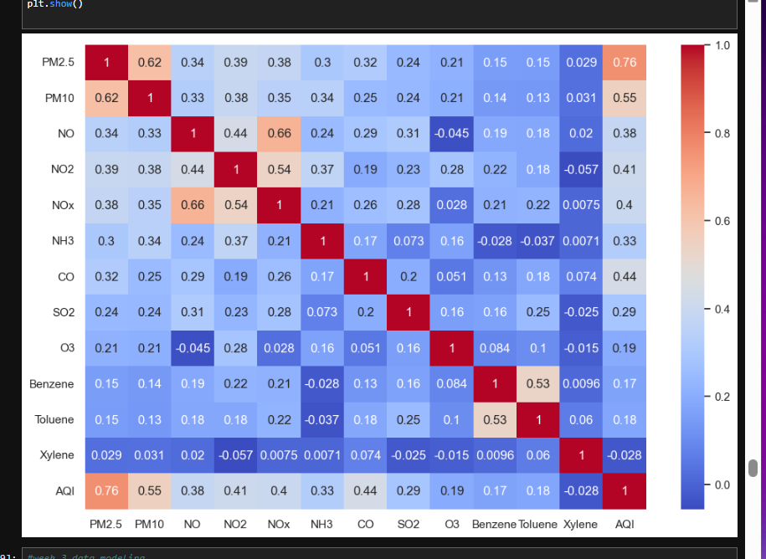
Screenshot of Output:

Slide 8
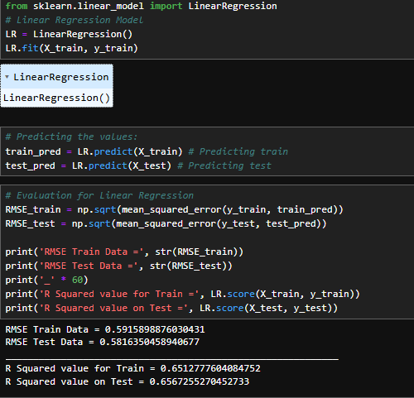
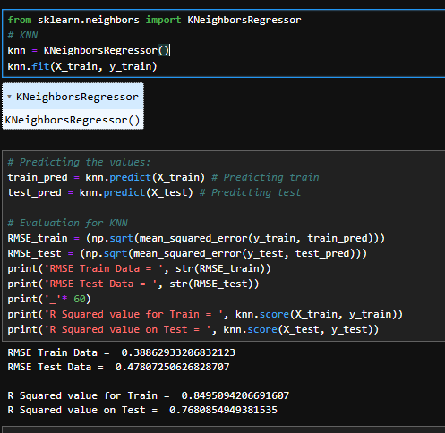
Screenshot of Output:

Slide 9
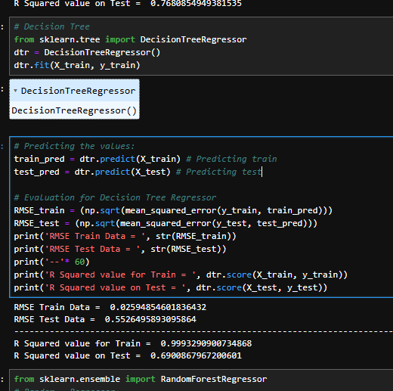
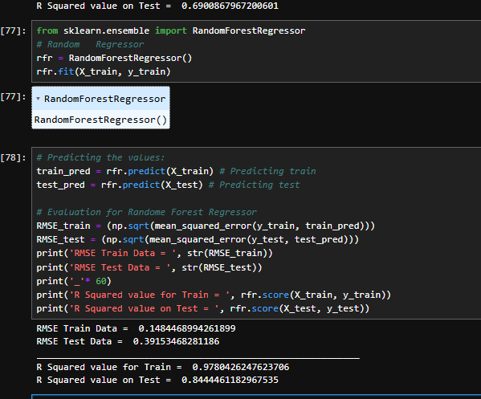
Screenshot of Output:

Slide 10
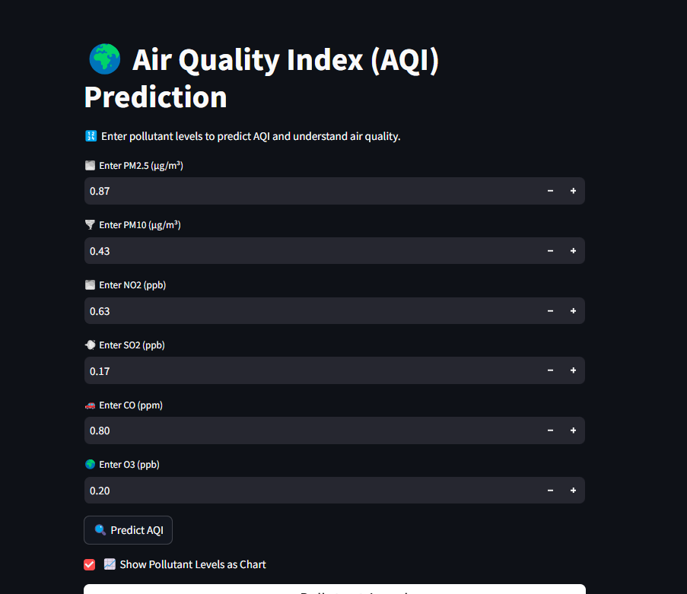
Screenshot of Output:

Slide 11
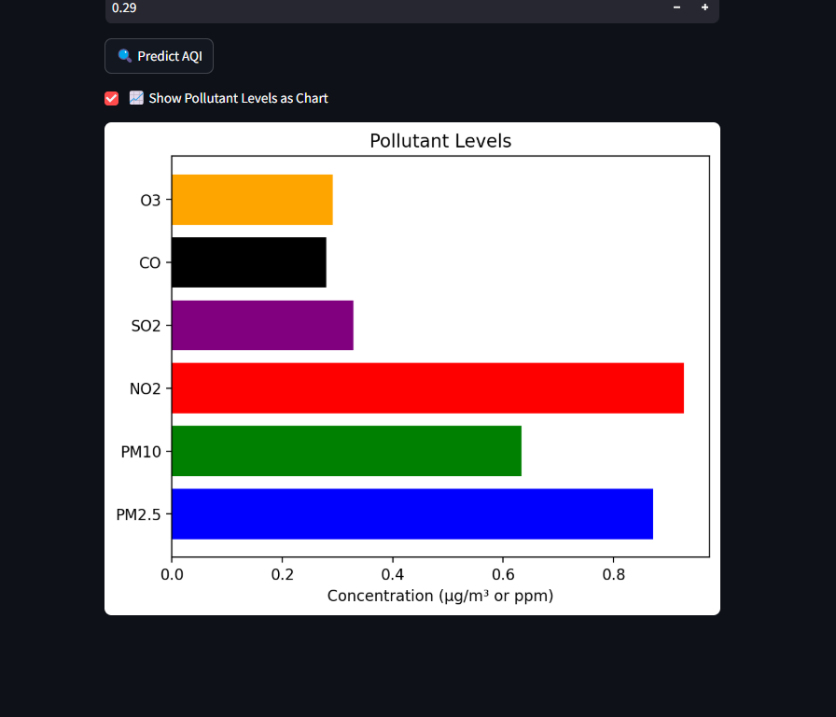
Screenshot of Output:

Slide 12
Conclusion:
This project demonstrates how machine learning can enhance air quality monitoring by predicting AQI from pollutant data. The developed model and web application provide an efficient and cost-effective way to assess air pollution levels in different locations, ultimately aiding in better environmental planning and public awareness.

